Slide 1
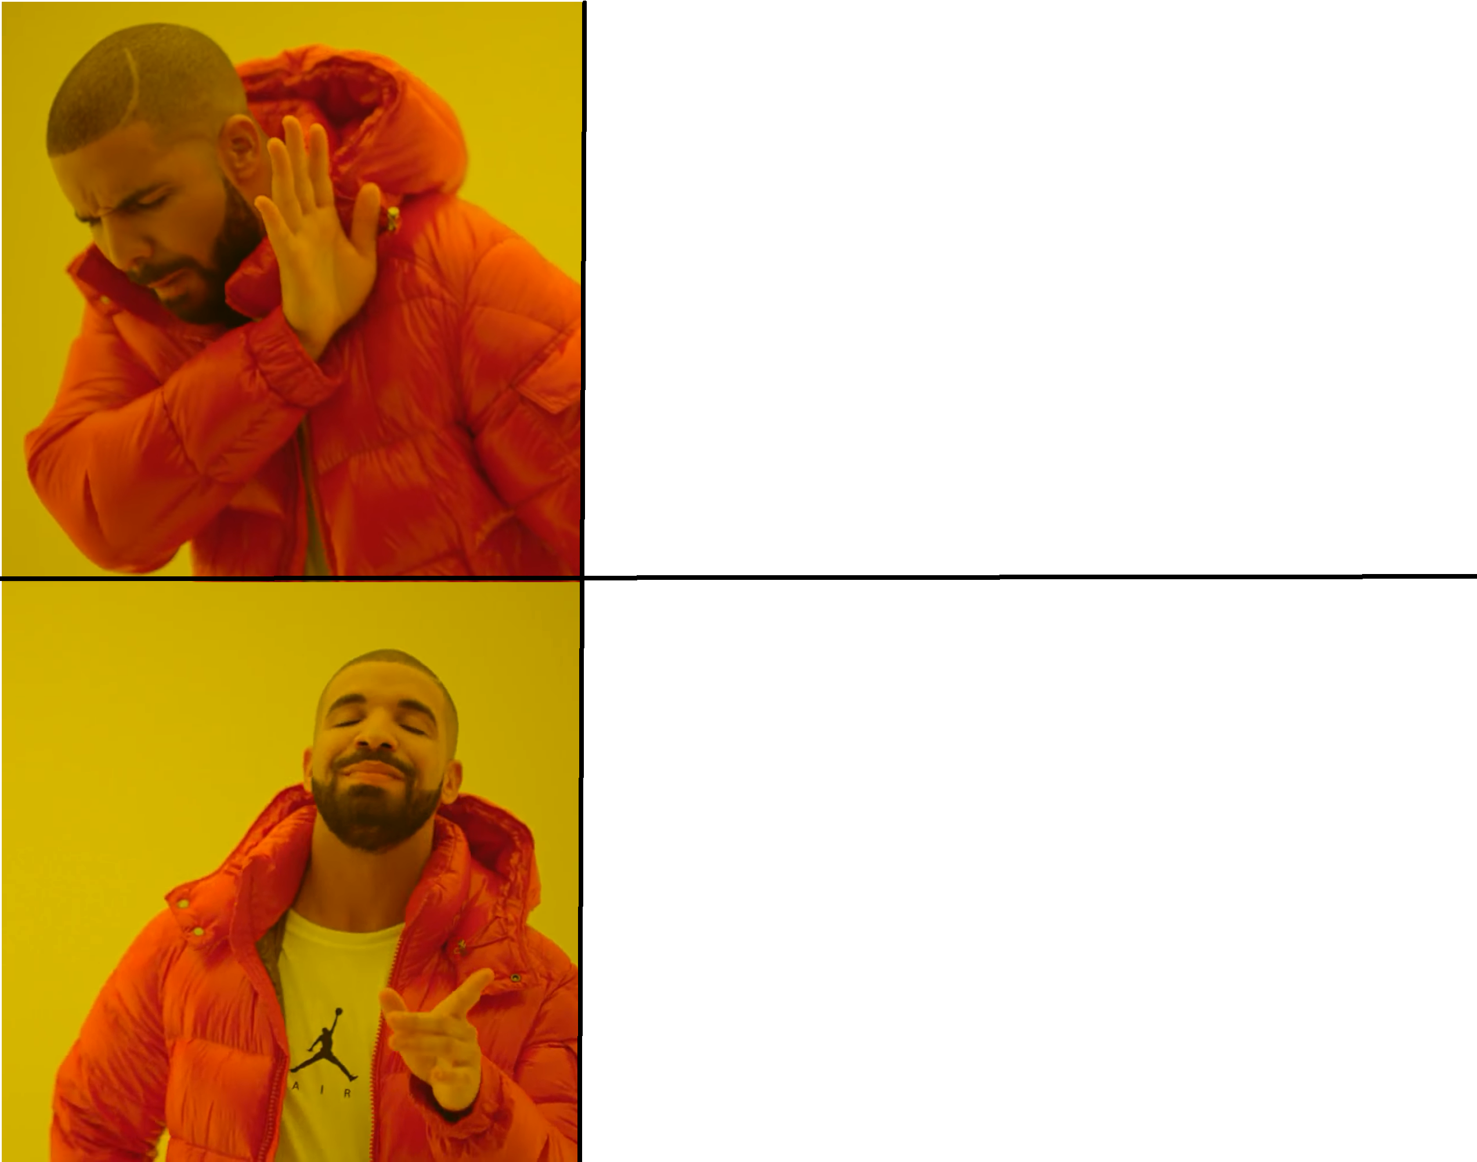
personal carbon footprint for
normal people
air conditioned hermetic
luxury privileges
for leaders
this meme was brought to you by the fine propagandists @ kohlbergs7.org
the best and (so far) the only place where the neomoralist maximist movement resides in demanding better leadership and moving from hiding behind the systemic to rising beyond systemic!
personal carbon footprint as a tool to measure leaders capabilities to learn about the systemic flaws that lead to overconsumption
better leaders for
normal people

Slide 2
depressed people void of free will waiting for systemic level resque operation
anxiety, lack of agency
this meme was brought to you by the fine propagandists @ kohlbergs7.org
the best and (so far) the only place where the neomoralist maximist movement resides in demanding better leadership and moving from hiding behind the systemic to rising beyond systemic!
active people forcing leaders to do better
self-efficacy, tactics, action

Slide 3
world of eternal growth forced by the superorganism
by corrupt dollar green, coal gray or oil brown leaders living in a fantasy world
this meme was brought to you by the fine propagandists @ kohlbergs7.org
the best and (so far) the only place where the neomoralist maximist movement resides in demanding better leadership and moving from hiding behind the systemic to rising beyond systemic!
world based laws of physics and actual resources
by based leaders living in the real world

Slide 4
banal evit
a leader hiding behind the systemic level. air conditioned hermetic luxury
this meme was brought to you by the fine propagandists @ kohlbergs7.org
the best and (so far) the only place where the neomoralist maximist movement resides in demanding better leadership and moving from hiding behind the systemic to rising beyond systemic!
epic praxis
rising beyond the systemic level where the theoretical ethics transform into practical epics

Slide 5
afraid to state what is right and wrong in terms of consumption
terrified of the possibility of personal change
this meme was brought to you by the fine propagandists @ kohlbergs7.org
the best and (so far) the only place where the neomoralist maximist movement resides in demanding better leadership and moving from hiding behind the systemic to rising beyond systemic!
proudly stating the maxims despite not being perfect

Slide 6
waiting
this meme was brought to you by the fine propagandists @ kohlbergs7.org
the best and (so far) the only place where the neomoralist maximist movement resides in demanding better leadership and moving from hiding behind the systemic to rising beyond systemic!
proudly stating the maxims despite not being perfect

Slide 7
moral and values only present in celebratory speeches and in abstract terms to avoid any reality impact
counting on systemic change that goes the wrong way in terms of democracy
this meme was brought to you by the fine propagandists @ kohlbergs7.org
the best and (so far) the only place where the neomoralist maximist movement resides in demanding better leadership and moving from hiding behind the systemic to rising beyond systemic!
planetary epic praxis – formerly known as universal ethical principles
set protopian targets –> maximism
test the limits of agency personally
apply pressure to higher levels of the foodchain

